Slide 1
Welcome!
Focus Group #2- post testing
April 15, 2016
6-7:00 pm

Slide 2


Communication Materials: Logo design (before)
Logo A- Plastic Free Hawaii 808
Logo B- Hawaii Girl 808.com

Slide 3

Communication Materials: Logo design (after)

Slide 4
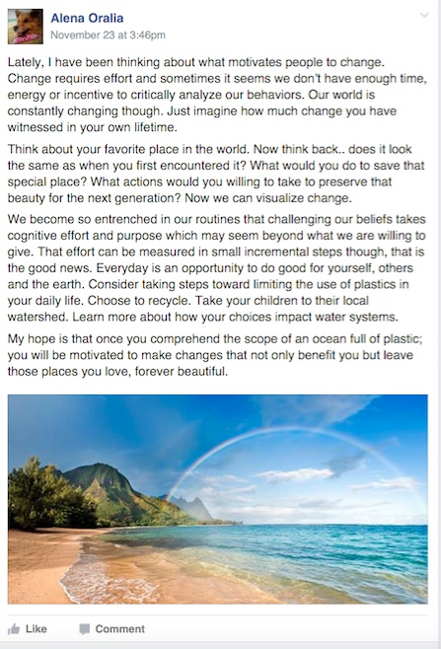
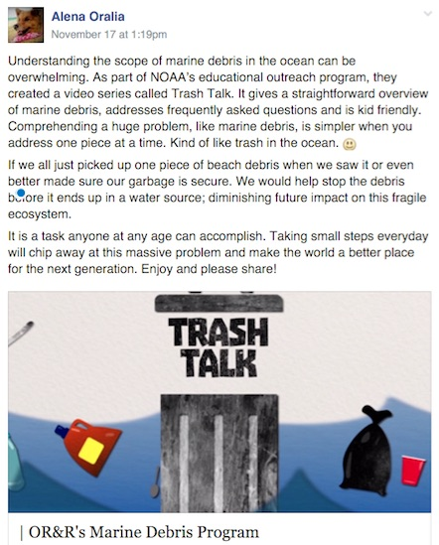
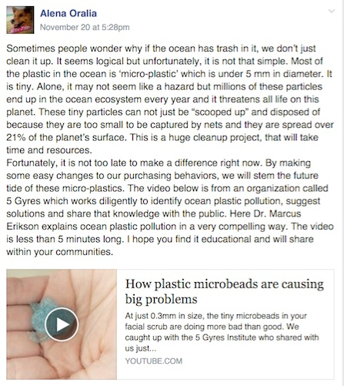
Communication Materials: Facebook posts (before)
Primary vs. Secondary source: establishing a voice and identity

Slide 5
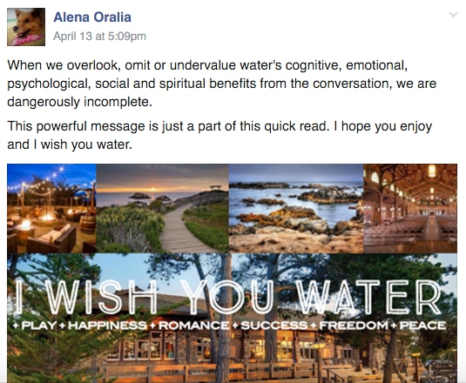
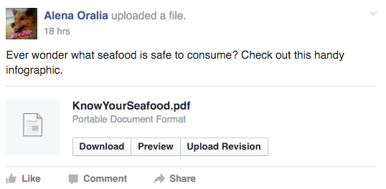
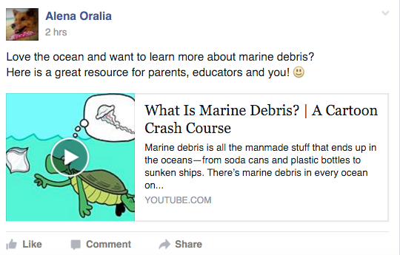
Communication Materials: Facebook posts (after)

Slide 6
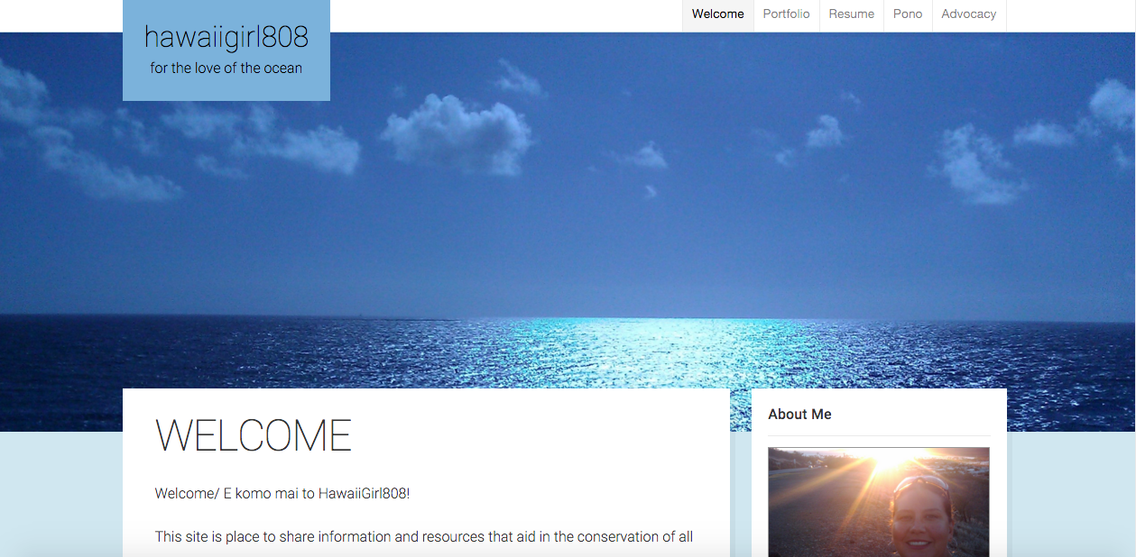
HawaiiGirl808.com
https://hawaiigirl808.com/

Slide 7

Conservation Video: Why the ocean matters

Slide 8
Thank you for your participation!
Mahalo

